Slide 1

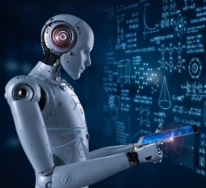
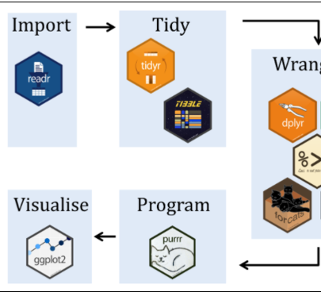
Data-422-20S2 Data WRANGLING
Lecturer’s: Giulio Dalla Riva, Thomas Li
University of Canterbury
By group - Data Wranglers
Team
Sharmistha Dutta (29625569)
Prasoon Sharma
Sanjay Girish Chauhan
Mahesh Pandey
Anoop
14th Oct 2020

Slide 2

objectives
To collect data from the reliable sources.
Cleaning and preprocessing.
Data analysis on movie data from IMDB and Rotten Tomatoes.
Data Wranglers

Slide 3


Ai and Cognitive Science
Research Questions
Data Wranglers
Data Wranglers
3

Slide 4




Data Sources
IMDB
Rotten Tomatoes
.
Data Wranglers

Slide 5



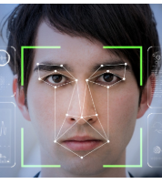
Approach/Methodology
Data Wranglers

Slide 6



Visualization
Data Wranglers

Slide 7

Challenges
Data Wranglers

Slide 8
challenges
To collect data from the reliable sources.
Cleaning and preprocessing.
Data analysis on movie data from IMDB and Rotten Tomatoes.
Data Wranglers

Slide 9

Conclusion
Effective and natural interaction between human and computers.
Removal of discrimination and unjust exclusion.
Designing of trustworthy and human-centred AI systems.
Regulating big data and transparency of algorithms.
Understanding of human cognition and artificial intelligence for future research.
Data Wranglers

